Slide 1
Building Linear Regression Models
Build Regression Models Using Linear Algebra
Build Regularized Regression Models Using Linear Algebra
Build Iterative Linear Regression Models

Slide 2

Build Regression Models Using Linear Algebra

Slide 3
Linear Regression
50
Dependent Variable
0
0
100
Independent Variable

Slide 4
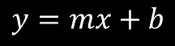
Linear Equation
$$y=mx+b$$
Linear equation—Describes a straight line in terms of x and y points within the line, the slope of the line, and the location where the line intercepts the y-axis when x is 0.
Where:
y is the y-value for a data example (the dependent variable).
x is the x-value for a data example (the independent variable).
m is the slope of the line, calculated by dividing the change in y by the change in x.
b is the intercept—the value of y when x is 0.
Provides a basis for understanding linear regression
Generates a straight line to fit linear data
Foundational concept in statistics

Slide 5
Linear Equation Data Example
Miles Driven in Thousands | Value in Thousands of Dollars
.10 | 48.70
1.09 | 47.30
8.71 | 43.90
28.54 | 44.25
41.92 | 39.50
57.13 | 45.60
89.54 | 27.20
97.12 | 34.00
103.00 | 39.20
125.43 | 27.40
139.10 | 31.85
145.02 | 20.65
163.21 | 24.40
194.98 | 43.00
224.63 | 13.25
50
Value ($K)
10
0
250
Mileage (K)

Slide 6
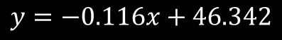
Straight Line Fit to Example Data (Slide 1 of 2)
$$y=−0.116x+46.342$$
50
Value ($K)
10
0
250
Mileage (K)

Slide 7
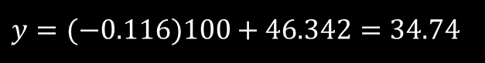
Straight Line Fit to Example Data (Slide 2 of 2)
$$y=(−0.116)100+46.342=34.74$$
50
Predicted value
Value ($K)
10
0
250
Mileage (K)

Slide 8
Linear Equation Shortcomings
Linear equation:
Provides a simple approach to make predictions based on a dataset.
Is not as powerful as other ways of applying linear regression to machine learning.
May not work well or as expected with data that cannot be fit linearly.
Fails to account for multiple predictors.
Example: Mileage is not the only factor that influences how much a car is worth. Other factors include the class of vehicle (e.g., sedan vs. tractor trailer), make, model, year of manufacture, year of sale, climate it's primarily driven in, who owned it, how well the previous owner treated it, and many more.
Machine learning tasks often necessitate somewhat more complex approaches to linear regression.

Slide 9
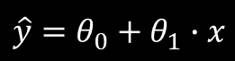
Linear Regression in Machine Learning
Linear regression—Provides a basic linear model in machine learning.
Where:
ŷ is the variable you're trying to predict (the dependent variable).
θ₀ is the intercept (equivalent to b in the linear equation).
θ₁ is a model parameter (equivalent to m in the linear equation). A model parameter is an independent variable relevant to the problem, and is usually just a feature of the data set.
x is the independent variable of interest—the features you'd extract and pass into the model.
$$\hat{y}=θ_{0}+θ_{1}∙x$$
Linear regression algorithm
Finds the error or cost
The difference between the input training data and the predictive line fit that the model generates
Each feature and any permutations generated by the practitioner during the feature engineering will have a corresponding parameter θi that the model must solve for.

Slide 10
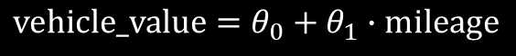
Linear Regression in Machine Learning Example
Vehicle value example:
Start by mapping a single feature, the vehicle's mileage, plugged into the formula as:
When you map this function to more features, you can evaluate the fit to a straight line.
If data fits to the line, that feature has a strong correlation with the prediction variable.
Linear regression is commonly used in supervised learning to predict numerical values (the dependent variables) that increase or decrease based on multiple features (the independent variables).
$$vehicle_value=θ_{0}+θ_{1}∙mileage$$

Slide 11
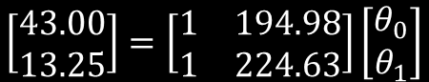
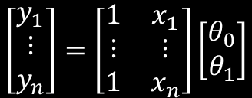
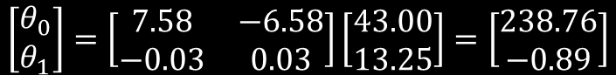
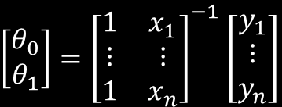
Matrices in Linear Regression
Single-parameter linear model equation—Represents linear equations for each value of x and y in a dataset.
$$\left[\begin{matrix}y_{1} \\ ⋮ \\ y_{n}\end{matrix}\right]=\left[\begin{matrix}1 & x_{1} \\ ⋮ & ⋮ \\ 1 & x_{n}\end{matrix}\right]\left[\begin{matrix}θ_{0} \\ θ_{1}\end{matrix}\right]$$
For simplicity's sake, consider how these matrices would be filled in using just the last two points of the vehicle value dataset: (194.98, 43.00) and (224.63, 13.25).
After applying the inverse matrix:
After plugging in the last two points of the dataset:
$$\left[\begin{matrix}43.00 \\ 13.25\end{matrix}\right]=\left[\begin{matrix}1 & 194.98 \\ 1 & 224.63\end{matrix}\right]\left[\begin{matrix}θ_{0} \\ θ_{1}\end{matrix}\right]$$
$\left[\begin{matrix}θ_{0} \\ θ_{1}\end{matrix}\right]={\left[\begin{matrix}1 & x_{1} \\ ⋮ & ⋮ \\ 1 & x_{n}\end{matrix}\right]}^{−1}$ $\left[\begin{matrix}y_{1} \\ ⋮ \\ y_{n}\end{matrix}\right]$
$$\left[\begin{matrix}θ_{0} \\ θ_{1}\end{matrix}\right]=\left[\begin{matrix}7.58 & −6.58 \\ −0.03 & 0.03\end{matrix}\right]\left[\begin{matrix}43.00 \\ 13.25\end{matrix}\right]=\left[\begin{matrix}238.76 \\ −0.89\end{matrix}\right]$$

Slide 12
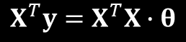
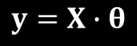
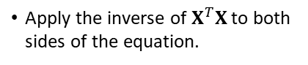
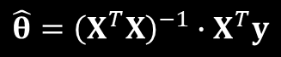
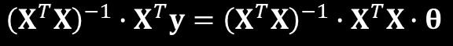
Normal Equation
You cannot take the inverse of a non-square matrix.
Problem: When you plug in 15 data points, you end up with a 15 × 2 matrix for the x values.
Solution: Take the pseudoinverse of the matrix.
Moore–Penrose Inverse.
Transposes the matrix of x values.
Normal equation takes this pseudoinverse.
A closed-form solution.
$$y=X∙θ$$
θ is a matrix of the model parameters. (e.g., m and b for slope and intercept).
X is a matrix of the x values.
y is the vector of y values.
$$X^{T}y=X^{T}X∙θ$$
Multiply each side of the equation by the transpose of X.
$${{\left(X^{T}X\right)}^{−1}∙X}^{T}y={\left(X^{T}X\right)}^{−1}∙\left.X^{T}X\right.∙θ$$
Apply the inverse of $X^{T}X$to both sides of the equation.
$$\hat{θ}={\left(X^{T}X\right)}^{−1}∙X^{T}y$$
Remove the right side of the equation (other than θ).

Slide 13
Linear Model with Higher Order Fits (Slide 1 of 2)
100
Temperature (℉)
50
0
25
Hour of Day

Slide 14
Linear Model with Higher Order Fits (Slide 2 of 2)
$$k=2$$
$$k=5$$
100
100
Temperature (℉)
Temperature (℉)
50
0
25
50
0
25
Hour of Day
Hour of Day
$$k=50$$
100
Temperature (℉)
50
0
25
Hour of Day

Slide 15
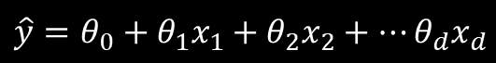
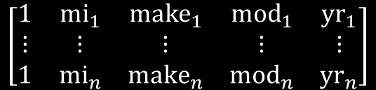
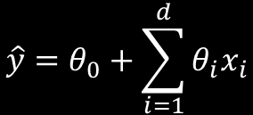
Linear Model with Multiple Parameters
$$\hat{y}=θ_{0}+θ_{1}x_{1}+θ_{2}x_{2}+⋯θ_{d}x_{d}$$
Linear regression can be expressed as a series of weighted features where:
d is the total number of model parameters (features).
θ_{i} is the i^{th} model parameter (and the intercept).
x_{i} is the i^{th} value of the feature.
$$\hat{y}=θ_{0}+\sum_{i=1}^{d}{θ_{i}x_{i}}$$
$$\left[\begin{matrix}1 & {mi}_{1} & {make}_{1} & {mod}_{1} & {yr}_{1} \\ ⋮ & ⋮ & ⋮ & ⋮ & ⋮ \\ 1 & {mi}_{n} & {make}_{n} & {mod}_{n} & {yr}_{n}\end{matrix}\right]$$
Each column represents an additional feature.
With several factors going into determining a vehicle's value, the matrix might look like this.
As before, this can be plugged into the normal equation to calculate the model parameters θ_{i}.
Combine this multi-parameter approach with a higher order approach:
By including transformations of the feature values.
To help generate a non-linear fit to data with multiple predictive features.

Slide 16
Cost Function
Cost Function: A function that attempts to quantify the error between the predicted values and the actual labeled training values.
A way to evaluate the performance of a model on training data.
Evaluates how poorly the model predicts—in other words, its cost.
Determines how bad model is at estimating relationship between dependent and independent variables.
The learning process involves minimizing this cost function.
Leads model toward optimal parameters.
Normal equation is one way of minimizing cost function.

Slide 17
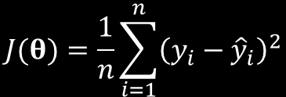
Mean Squared Error (MSE)
Mean squared error is used as a simple and effective cost function for linear regression, where:
n is the size of the training set, i.e., the total number of examples.
y_{i} is the actual value of a variable.
ŷ_{i} is the predicted value of the variable.
J(θ) is the cost function itself.
$$J(θ)=\frac{1}{n}\sum_{i=1}^{n}{{\left(y_{i}−{\hat{y}}_{i}\right)}^{2}}$$
Commonly used for linear regression.
Usually simplest and most effective cost function.
Error is calculated, then squared, then average is taken.
Squaring makes all values positive; otherwise, average trends toward 0.
Mean absolute error (MAE) is an alternative measure of cost function.

Slide 18
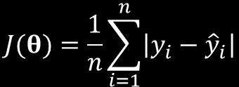
Mean Absolute Error (MAE)
Mean absolute error is an alternative cost function, where:
n is the size of the training set, i.e., the total number of examples.
y_{i} is the actual value of a variable.
ŷ_{i} is the predicted value of the variable.
J(θ) is the cost function itself.
Doesn't consider sign of values.
Unlike MSE, MAE doesn't:
Minimize errors much less than 1.
Exaggerate errors much greater than 1.
However, MSE is preferred because:
It is differentiable.
It matches what the linear equation is minimizing.
$$J(θ)=\frac{1}{n}\sum_{i=1}^{n}{\left|y_{i}−{\hat{y}}_{i}\right|}$$

Slide 19
Coefficient of Determination
Coefficient of Determination: A statistical measure indicating how much of a dependent variable's variance is explainable by the model.
Also called R².
Used as scoring method for linear regression models.
Always between 0 and 1.
Perfectly hitting all points on the line would be a 1.
As line misses more and more points, R² decreases toward 0.
Decreasing R² is less and less able to explain variance.
R² of 0.76 means 76% of variance in label is explainable by the model.
High R² does not always mean a more skillful model, and vice versa.
Low R² may have more predictive power than high R².
R² can change dramatically from model to model, but predictive error may stay the same.
Strong connection between variable does not always imply strong causality.
Minimizing MSE is preferable to optimizing R².

Slide 20
Normal Equation Shortcomings
Normal equation works well in many cases, but is not perfect for all.
Two major issues:
Memory issues with large datasets.
Solved through iterative cost minimization.
Overfitting.
Solved through regularization.

Slide 21

Build a Linear Regression Model
Use linear regression in supervised learning to predict the change in value of a numeric dependent variable in relation to one or more independent variables.
Consider that some data is not easily fit by a straight line—i.e., higher order fits.
Use various transformations on the data, like exponent and logarithm, and add them as new features to account for higher order fits.
Observe how adding more feature transformations changes a higher order fit, and consider that adding too many will lead to overfitting.
Consider that linear regression models are usually not evaluated based on how well they fit, but on how poorly they fit (the cost).
Prefer using a cost function like mean squared error (MSE) over R2 when evaluating the skill of a linear regression model.
Prefer using MSE over mean absolute error (MAE).
Keep in mind the shortcomings of the closed-form normal equation: that large datasets will lead to memory issues due to the computational cost of inverse matrix calculations, and that it is prone to overfitting.

Slide 22
Use Python for Linear Regression
Use scikit-learn's LinearRegression() class to build simple linear models:
model = sklearn.linear_model.LinearRegression()
model.fit(X_train, y_train)
model.score(X_test, y_test)
model.predict(X_test)
sklearn.metrics.mean_squared_error(y_test, prediction)
model.coef_

Slide 23

Activity: Building a Regression Model Using Linear Algebra
IOT Company:
Supplies network-connected sensors
Used in power plants to measure ambient conditions inside and outside the plant, such as temperature and humidity, which affect the efficiency of the power plant's energy output.
You have been:
Given a dataset with hourly measurements over a six-year period.
Tasked with predicting the energy output of the plant given certain measurements.
Because energy output is measured in megawatts (MW), a numeric value, you'll use a simple linear model to make these predictions.
IOT
COMPANY

Slide 24

Activity: (Optional) Building a Linear Regression Model to Predict Diabetes Progression
GCPG is a medical practice that treats diabetes patients.
Wants to know when patient is at risk of progressing to later stages.
You have an anonymized dataset of patients with various medical attributes.
You need to predict diabetes progression based on data.
The progression factor is a numeric value, so you'll use linear regression.

Slide 25
Build Regularized Regression Models Using Linear Algebra

Slide 26
Regularization Techniques
Regularization applies λ hyperparameter to constrain a model.
Reduces overfitting.
λ is part of a term that is added to cost function.
Term penalizes model if parameters are too high.
Keeps parameters small.
Different regularization techniques use different terms.
Three most successful techniques:
Ridge
Lasso
Elastic net
Good idea to apply regularization to most models, regardless of type chosen.
Regularize during training only, not during evaluation phase.

Slide 27
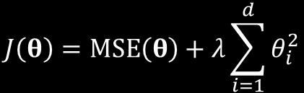
Ridge Regression
Ridge Regression: A form of regularization that uses the ℓ₂ norm to implement its regularization term.
ℓ₂ norm is the sum of square coefficients.
Minimizing it keeps parameter weights small.
Suitable in datasets with many features, each having some predictive power.
Ridge regression doesn't remove features entirely.
Ridge regression applied to MSE cost function, where:
J(θ) is the cost function itself, now with regularization term applied.
MSE(θ) is the cost function before regularization.
λ is the regularization hyperparameter.
d is the total length of θ.
θ_{i} is a model parameter.
$$J\left(θ\right)=MSE\left(θ\right)+λ\sum_{i=1}^{d}{θ_{i}^{2}}$$

Slide 28
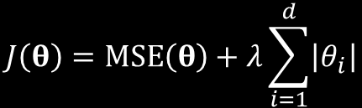
Lasso Regression
Lasso Regression: A form of regularization that uses the ℓ₁ norm to implement its regularization term.
ℓ₁ norm forces coefficients of least relevant features to 0.
Removes them from the model.
Suitable in datasets with small or moderate number of features with moderate predictive power.
Eliminates features with no significant effect on data.
Performs a type of feature selection.
Lasso regression applied to MSE cost function, where:
J(θ) is the cost function itself, now with regularization term applied.
MSE(θ) is the cost function before regularization.
λ is the regularization hyperparameter.
d is the total length of θ.
θ_{i} is a model parameter.
$$J\left(θ\right)=MSE\left(θ\right)+λ\sum_{i=1}^{d}{\left|θ_{i}\right|}$$

Slide 29
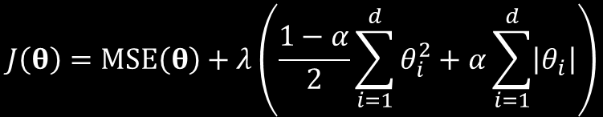
Elastic Net Regression
Elastic Net Regression: A form of regularization that uses a weighted average of both ridge and lasso regression as part of its regularization term.
Leverages best of both ℓ₁ and ℓ₂ norms.
Uses λ, but also uses α ratio hyperparameter.
α of 0 uses ℓ₂ term.
α of 1 uses ℓ₁ term.
Find the value in between that best optimizes regularization.
Suitable for datasets with small to moderate number of features that are relevant.
In most cases, prefer elastic net over lasso.
Ridge may be preferable when removing even some features impairs model's skill.
Elastic net regression applied to MSE cost function, where:
J(θ) is the cost function itself, now with regularization term applied.
MSE(θ) is the cost function before regularization.
λ is the regularization hyperparameter.
d is the total length of θ.
θ_{i} is a model parameter.
$$J\left(θ\right)=MSE\left(θ\right)+λ\left(\frac{1−α}{2}\sum_{i=1}^{d}{θ_{i}^{2}}+α\sum_{i=1}^{d}{\left|θ_{i}\right|}\right)$$

Slide 30
Build a Regularized Linear Regression Model
Perform regularization only during training.
Consider ridge with datasets that have many features with some predictive power.
Consider lasso with datasets that have small to moderate number of features.
Consider elastic net with datasets that have small to moderate number of features.
Prefer elastic net over lasso in most cases.
Prefer ridge if removing features has a negative impact on model skill.
Consider applying multiple types of regression to see which is better.
Prefer any regularization over none at all.

Slide 31
Use Python for Regularized Linear Regression
Use scikit-learn's Ridge(), Lasso(), and ElasticNet() classes to build regularized models:
model = sklearn.linear_model.Ridge(alpha = 0.1)
model = sklearn.linear_model.Lasso(alpha = 0.1)
model = sklearn.linear_model.ElasticNet(alpha = 0.1, l1_ratio = 0.5)
Use same methods/attributes as with LinearRegression().

Slide 32
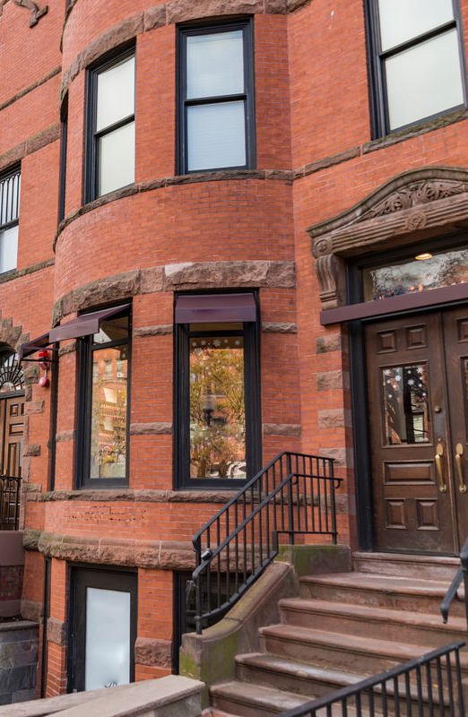
Activity: Building a Regularized Linear Regression Model
You want to:
Apply your house valuation models to houses in Boston, Massachusetts.
Train a model to predict the value of a home in this area given several factors.
Simple linear regression is not necessarily the best way to address this problem.
You want to avoid overfitting to the training data, making the model less useful to generalize to new data.
So, you'll apply regularization to your linear models to help simplify the models and avoid overfitting.
You'll evaluate all three types of regularization (ridge, lasso, and elastic net), and then choose which one performs the best according to your requirements.

Slide 33
Build Iterative Linear Regression Models

Slide 34
Iterative Models
Computational expensive of closed-form solution necessitates a different approach.
In iterative approach, model minimizes cost by gradually approaching a minimum.
Does so after repeated calculations (iterations).
Doesn't always find the "true" minimum, but usually provides a good enough result.
Feature scaling is more important for iterative methods.
Different scales impair model's ability to gradually approach desired cost minimum.
Always scale features when training iterative models.

Slide 35
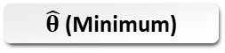
Gradient Descent
Start value
Cost
$\hat{θ}$ (Minimum)
Model Parameters

Slide 36
Global Minimum vs. Local Minima
Cost
Local minimum
Global minimum
Model Parameters

Slide 37
Small Learning Rate
Start value
Cost
Model Parameters

Slide 38
Large Learning Rate
Cost
Start value
Model Parameters

Slide 39
Gradient Descent Techniques
Gradient Descent Techniques | Description
BGD | Uses entire training set to calculate step-wise gradients. Each example has its own gradient. Model params updated based on average gradient of all examples. Not commonly used; takes a very long time to compute gradients.
SGD | Selects example at random and computes gradient at every step. Much quicker than BGD. Example update may cancel out updates from previous example. Progress is made slowly in correct direction.
SAG | Similar to SGD, but has a memory of previously computed gradients. Converges faster than SGD. Only supports ℓ₂ regularization. May have performance issues in large datasets.
MBGD | Middle ground between BGD and SGD. Selects a group of examples at random. Steps in direction of average gradient from all examples in group. May perform better than SGD, especially when backed by GPUs.

Slide 40
Build an Iterative Linear Regression Model
Consider using iterative techniques with 10,000+ data examples/features.
Tune learning rate over several epochs.
Start with a higher learning rate and gradually decrease it over time.
Prefer SGD/SAG to BGD to save time/memory.
Consider MBGD as a middle ground.

Slide 41
Use Python for Iterative Linear Regression
Several scikit-learn classes can implement iterative techniques through solver parameter. Example:
model = sklearn.linear_model.Ridge(alpha = 0.1, solver = 'sag')
For a specific application of gradient descent that is customizable, use SGDRegressor():
model = sklearn.linear_model.SGDRegressor(penalty = 'l2', alpha = 0.1, learning_rate = 'constant', eta0 = 0.05)
Use same methods/attributes as before.

Slide 42
Activity: Building an Iterative Linear Regression Model
As you continue expanding the scope of your real estate models, you realize that you'll quickly be training on very large datasets:
Hundreds of thousands of examples
Hundreds or perhaps thousands of features
The typical closed-form solution of the normal equation will:
Become a burden on training performance.
Slow down the process to a potentially unacceptable degree.
So, you will:
Try implementing an alternative cost minimization technique like gradient descent to hopefully cut down on training time.
Begin by retraining your Boston housing model.

Slide 43
What type of data in your organization do you think might be conducive to a linear regression analysis?
Do you believe your data is best approached by a closed-form solution or an iterative one? Why?

